Slide 1



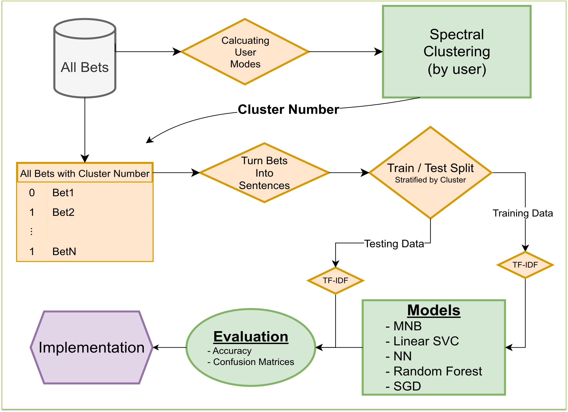
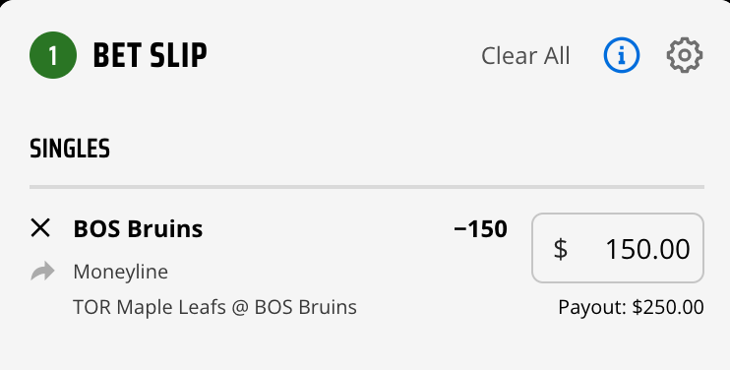
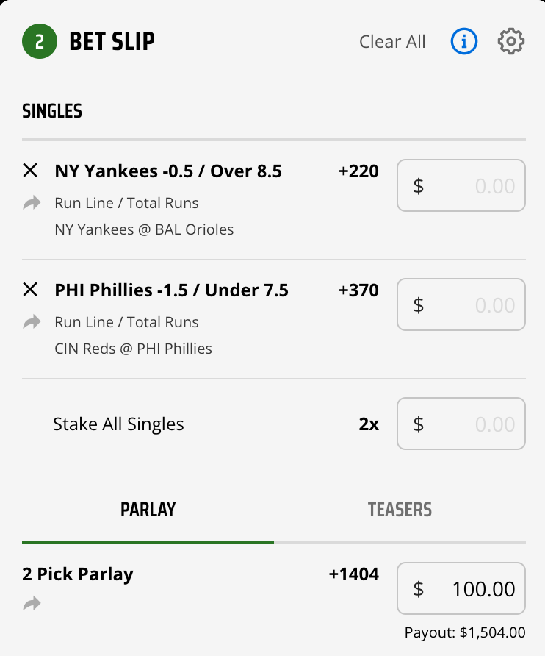
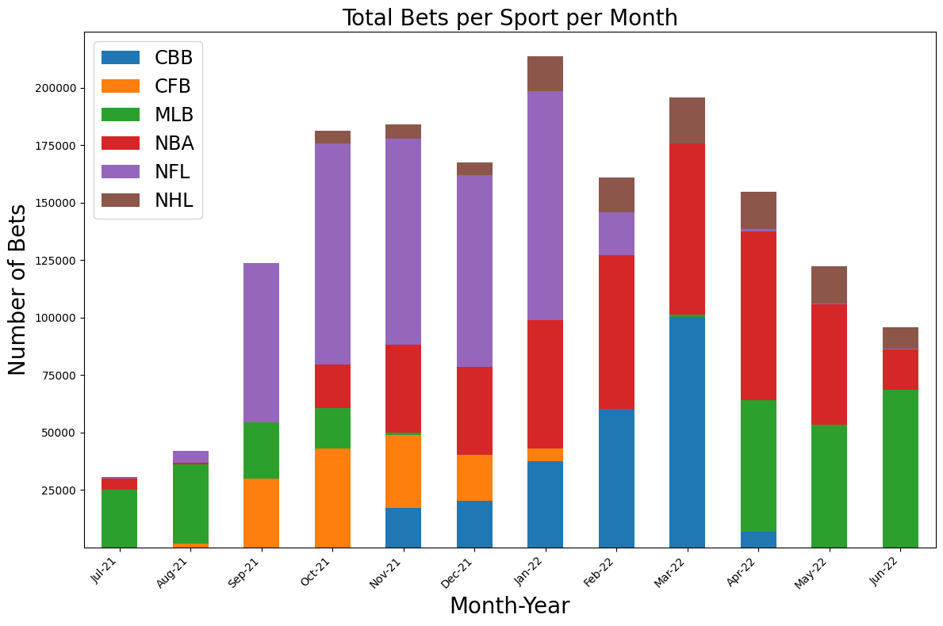
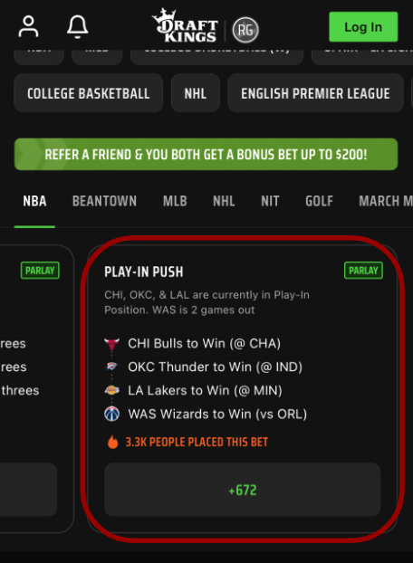
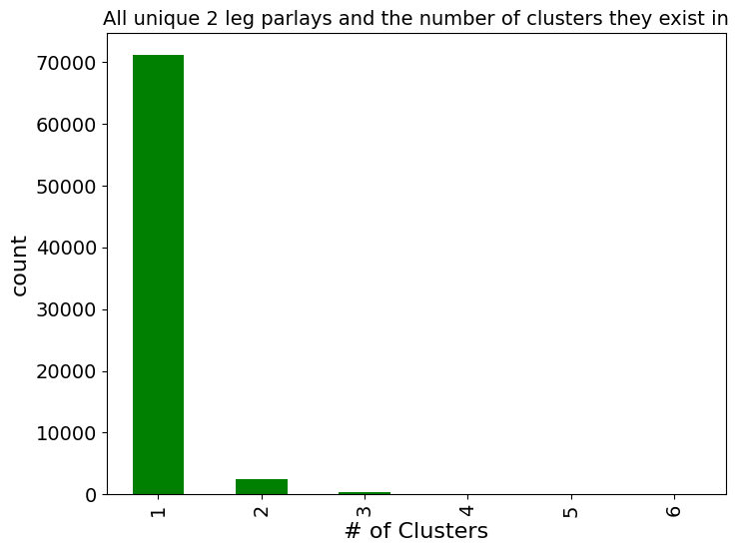
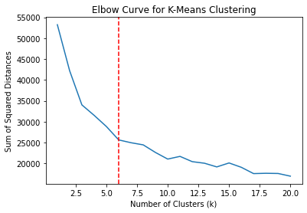
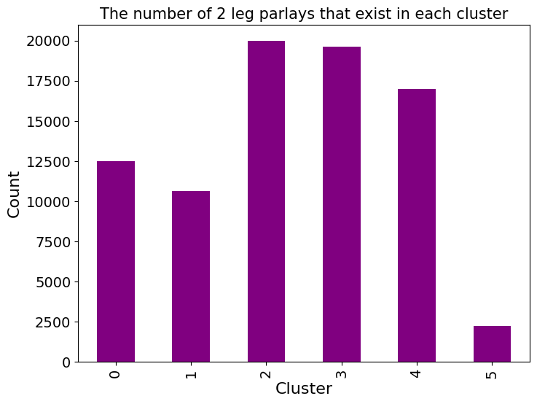
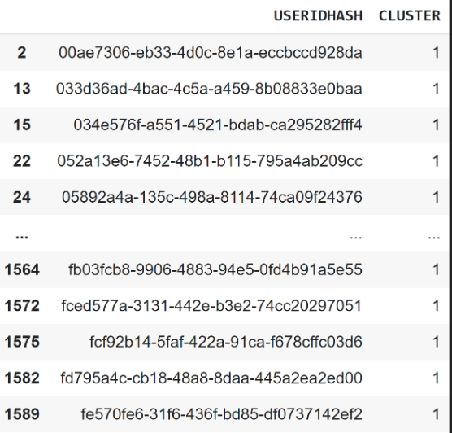
Multi-Class Classification of Bets and Parlays
for DraftKings Sportsbook
Grace Casey, Ryan Dieselman, Jack Fredo, Jackson Lombardi, Cameron Tomko
Advisor: Professor Donald Brown
Problem Statement
Process Flow Diagram
Results and Implementation
Create bet and parlay recommendations that are personalized to each user by using betting history data provided by DraftKings.
Model | All individual bets | 2-leg parlays | All-leg parlays
Random Baseline | 0.167 | 0.167 | 0.167
Most popular cluster baseline | 0.263 | 0.244 | 0.276
Multinomial Naive Bayes | 0.475 | 0.437 | 0.489
Stochastic Gradient Descent | 0.435 | 0.383 | 0.393
Linear SVC | 0.454 | 0.446 | 0.475
Deep Neural Network | 0.510 | 0.450 | 0.508
LSTM NN | 0.511 | 0.420 | 0.480
Background: Individual Bets vs. Parlays
Single Bet
Parlay Bet
DNN had great improvement compared to the random baseline model:
About the Data
Individual Bets: 2.3x better
2-Leg Parlays: 3.1x better
All-Leg Parlays: 2.9x better
Before cleaning and feature engineering the data, the original dataset had over 1.9 million rows and 22 different features.
Our dataset consisted of betting history from July 2020 to June 2021 from 1597 unique users.
How our model would work with live data :
Parlay:
“Moneyline Moneyline CHI Bulls CHA Hornets CHI Bulls low Moneyline Moneyline OKC Thunder IND Pacers OKC Thunder low Moneyline Moneyline LA Lakers MIN Timberwolves LA Lakers low Moneyline Moneyline WAS Wizards WAS Wizards ORL Magic low”
Cluster Analysis
Clustering Algorithm​ | Silhouette Coefficient​ | Calinski-Harabasz Index​ | Davies-Bouldin Index​
KMeans (Summary Matrix)​ | -0.017584​ | 0.81873​ | 34.906151​
KMeans (Jaccard/Summary Matrix)​ | 0.135527​ | 188.880706​ | 2.908899​
SOMSC (Summary Matrix)​ | -0.018811​ | 1.020206​ | 31.067871​
SOMSC (Jaccard/Summary Matrix)​ | -0.018783​ | 0.934873​ | 32.84831​
Spectral Clustering​ | 0.114418​ | 194.949369​ | 2.173085​
Hierarchical Clustering​ | -0.237143​ | 1.084555​ | 18.741318​
Potential Parlay
Creating Clusters
Parlay sentence
into
Model
Used an Elbow Curve to determine the optimal number of clusters.
Assign this parlay to users in Cluster 1
Neural Network:
Which Cluster does the parlay fit best?
K = 6
Cluster
Assignment
Users in Cluster 1
Parlay fits best in:
Cluster 1
Notes:
Instead of heat map, include the counts of user across clusters histogram

